Slide 1
Software Requirements Engineering
By
Abid Ali
BS Software Engineering
5th
Lecture #8

Slide 2
Part II
Requirements Development

Slide 3
Agenda
Defining business requirements . . . . . . . . . .
Identifying desired business benefits . . .
Product vision and project scope . . . .
Conflicting business requirements . . . . .
Vision and scope document . . . . . . . . . . . . . .
Business requirements . . . . . . . . . . . . . .
Scope and limitations . . . . . . . . . . . . . . .
Business context . . . . . . . . . . . . . . . . . . .
Deployment considerations………

Slide 4
Defining Business Requirements
“Business requirements” refers to a set of information that, in the aggregate, describes a need that leads to one or more projects to deliver a solution and the desired ultimate business outcomes.
Business opportunities, business objectives, success metrics, and a vision statement make up the business requirements.

Slide 5
Cont..
Identifying Desired Business Benefits:
The business requirements set the context for, and enable the measurement of, the benefits the business hopes to achieve from undertaking a project.
Organizations should not initiate any project without a clear understanding of the value it will add to the business. Set measurable targets with business objectives, and then define success metrics that allow you to measure whether you are on track to meet those objectives.

Slide 6
Cont..
Product Vision And Project Scope:
Two core elements of the business requirements are the vision and the scope.
The product vision succinctly describes the ultimate product that will achieve the business objectives.
This product could serve as the complete solution for the business requirements or as just a portion of the solution.
The vision describes what the product is about and what it ultimately could become.
It provides the context for making decisions throughout the product’s life, and it aligns all stakeholders in a common direction.
The project scope identifies what portion of the ultimate product vision the current project or development iteration will address.
The statement of scope draws the boundary between what’s in and what’s out for this project.

Slide 7
Cont..
Conflicting business requirements:
Business requirements collected from multiple sources might conflict. Consider a kiosk that will be used by a retail store’s customers.
Figure 5-2 shows the likely business interests of the kiosk developer, retailer, and customer as we envision how each of these stakeholders hopes the kiosk will provide an advantage over their current way of doing business.

Slide 8
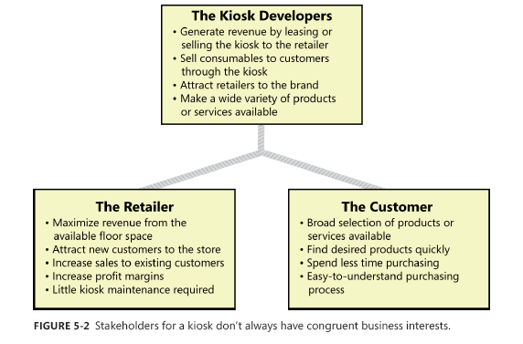
Cont..

Slide 9
Cont..
Vision and scope document :
The vision and scope document collects the business requirements into a single deliverable that sets the stage for the subsequent development work.
Some organizations create a project charter ( Wiegers 2007) or a business case document that serves a similar purpose.
Organizations that build commercial software often create a market (or marketing) requirements document (MRD).
An MRD might go into more detail about the target market segments and the issues that pertain to commercial success.

Slide 10
Cont..
The owner of the vision and scope document is the project’s executive sponsor, funding authority, or someone in a similar role.
A business analyst can work with this individual to articulate the business requirements and write the vision and scope document.
Input to the business requirements should come from people who have a clear sense of why they are undertaking the project.
These individuals might include the customer or development organization’s senior management, a product visionary, a product manager, a subject matter expert, or members of the marketing department.

Slide 11
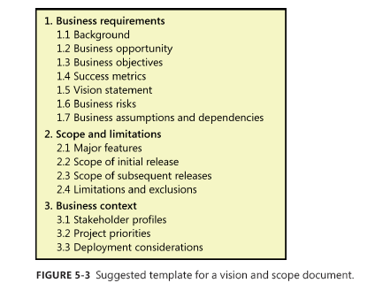
Cont..

Slide 12
Cont..
1. Business requirements:
Projects are launched in the belief that creating or changing a product will provide worthwhile benefits for someone and a suitable return on investment.
The business requirements describe the primary benefits that the new system will provide to its sponsors, buyers, and users.
Business requirements directly influence which user requirements to implement and in what sequence.

Slide 13
Cont..
1.1 Background
Summarize the rationale and context for the new product or for changes to be made to an existing one. Describe the history or situation that led to the decision to build this product.

Slide 14
Cont..
1.2 Business opportunity
For a corporate information system, describe the business problem that is being solved or the process being improved, as well as the environment in which the system will be used.
For a commercial product, describe the business opportunity that exists and the market in which the product will be competing.
This section could include a comparative evaluation of existing products, indicating why the proposed product is attractive and the advantages it provides

Slide 15
Cont..
1.3 Business objectives
Summarize the important business benefits the product will provide in a quantitative and measurable way.
Organizations generally undertake a project to solve a problem or exploit an opportunity.
A business objectives model shows a hierarchy of related business problems and measurable business objectives (Beatty and Chen 2012).
The problems describe what is keeping the business from meeting their goals at present, whereas the objectives define ways to measure achievement of those goals. Problems and objectives are intertwined: understanding one can reveal the other.

Slide 16
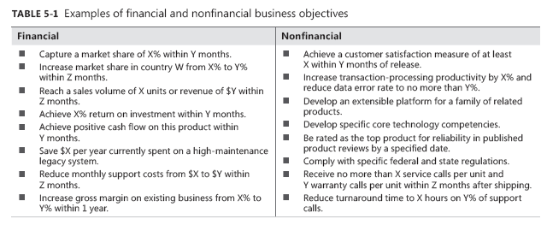
Cont..

Slide 17
Cont..
1.4 Success metrics
Specify the indicators that stakeholders will use to define and measure success on this project (Wiegers 2007).
Identify the factors that have the greatest impact on achieving that success, including factors both within and outside the organization’s control.

Slide 18
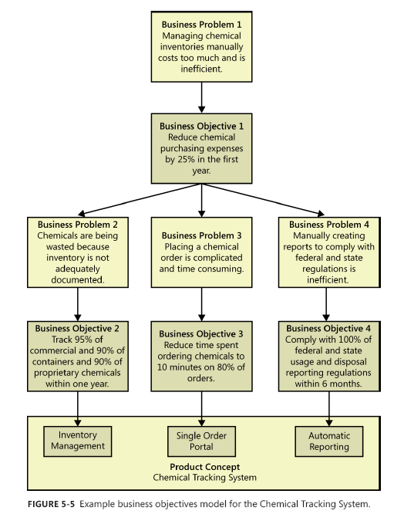
Cont..

Slide 19
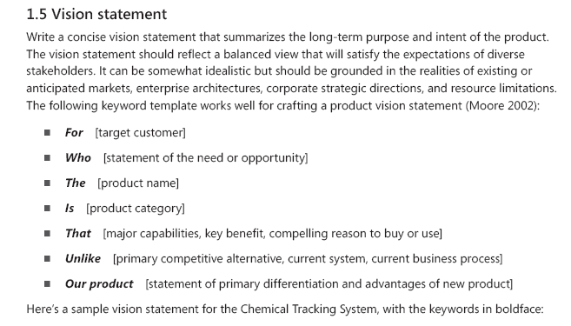
Cont..

Slide 20
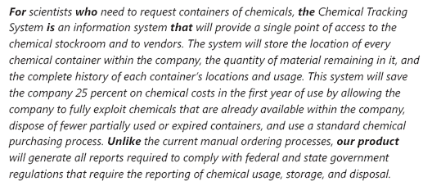
Sample vision statement for the Chemical Tracking System, with the keywords in boldface:

Slide 21
Cont..
1.6 Business risks
Summarize the major business risks associated with developing—or not developing—this product.
categories include marketplace competition, timing issues, user acceptance, implementation issues, and possible negative impacts on the business.
Business risks are not the same as project risks, which often include resource availability concerns and technology factors.
Estimate the potential loss from each risk, the likelihood of it occurring, and any potential mitigation actions

Slide 22
Cont..
1.7 Business assumptions and dependencies
An assumption is a statement that is believed to be true in the absence of proof or definitive knowledge. Business assumptions are specifically related to the business requirements.
Incorrect assumptions can potentially keep you from meeting your business objectives

Slide 23
Cont..
2. Scope and Limitations:
Software project should define its scope and limitations.
You need to state both what the solution being developed is and what it is not.
Many projects suffer from scope creep—rampant growth as more and more functionality gets stuffed into the product.
The first step to controlling scope creep is to define the project’s scope.
The scope describes the concept and range of the proposed solution.
The limitations itemize certain capabilities that the product will not include that some people might assume will be there.
The scope and limitations help to establish realistic stakeholder expectations because customers sometimes request features that are too expensive or that lie outside the intended project scope

Slide 24
Cont..
2.1 Major features
List the product’s major features or user capabilities, emphasizing those that distinguish it from previous or competing products.
Think about how users will use the features, to ensure that the list is complete and that it does not include unnecessary features that sound interesting but don’t provide customer value

Slide 25
Cont..
2.2 Scope of initial release
Summarize the capabilities that are planned for inclusion in the initial product release.
Scope is often defined in terms of features, but you can also define scope in terms of user stories, use cases, use case flows, or external events.
Also describe the quality characteristics that will let the product provide the intended benefits to its various user classes.
To focus the development effort and maintain a reasonable project schedule, avoid the temptation to include every feature that any potential customer might eventually want in release 1.0.
Bloatware and slipped schedules are common outcomes of such insidious scope stuffing.
Focus on those features that will provide the most value, at the most acceptable cost, to the broadest community, in the earliest time frame.

Slide 26
Cont..
2.3 Scope of subsequent releases:
If you envision a staged evolution of the product, or if you are following an iterative or incremental life cycle, build a release roadmap that indicates which functionality chunks will be deferred and the desired timing of later releases.
Subsequent releases let you implement additional use cases and features, as well as enriching the capabilities of the initial ones

Slide 27
Cont..
2.4 Limitations and exclusions:
List any product capabilities or characteristics that a stakeholder might expect but that are not planned for inclusion in the product or in a specific release.
List items that were cut from scope, so the scope decision is not forgotten.
Maybe a user requested that she be able to access the system from her phone while away from her desk, but this was deemed to be out of scope.
State that explicitly in this section: “The new system will not provide mobile platform support.”

Slide 28
3. Business context
This section presents profiles of major stakeholder categories, management’s priorities for the project, and a summary of some factors to consider when planning deployment of the solution.

Slide 29
Cont..
3.1 Stakeholder profiles
Stakeholders are the people, groups, or organizations that are actively involved in a project, are affected by its outcome, or are able to influence its outcome (Smith 2000; IIBA 2009; PMI 2013).
The stakeholder profiles describe different categories of customers and other key stakeholders for the project.

Slide 30
Cont..
Each stakeholder profile should include the following information:
The major value or benefit that the stakeholder will receive from the product. Stakeholder value could be defined in terms of:
Improved productivity
Reduced rework and waste.
Cost savings.
Streamlined business processes

Slide 31
Cont..
Automation of previously manual tasks.
Ability to perform entirely new tasks.
Compliance with pertinent standards or regulations.
Improved usability compared to current products.
Their likely attitudes toward the product.
Major features and characteristics of interest.
Any known constraints that must be accommodated

Slide 32
Cont..
3.2 Project priorities:
To enable effective decision making, the stakeholders must agree on the project’s priorities.
One way to approach this is to consider the five dimensions of features, quality, schedule, cost, and staff (Wiegers 1996).
Each dimension fits in one of the following three categories on any given project:
Constraint A limiting factor within which the project manager must operate
Driver A significant success objective with limited flexibility for adjustment
Degree of freedom A factor that the project manager has some latitude to adjust and balance against the other dimensions

Slide 33
Cont..
Suppose marketing suddenly demands that you release the product one month earlier than scheduled. How do you respond? Do you:
Defer certain requirements to a later release?
Shorten the planned system test cycle?
Demand overtime from your staff or hire contractors to accelerate development?
Shift resources from other projects to help out?

Slide 34
Cont..
3.3 Deployment considerations:
Summarize the information and activities that are needed to ensure an effective deployment of the solution into its operating environment.
Describe the access that users will require to use the system, such as whether the users are distributed over multiple time zones or located close to each other.

Slide 35
The End
Thank You

